Slide 1
Knee Osteoarthritis
Early Detection of Knee Osteoarthritis and determining it’s severity degree based on deep neural network

Slide 2
Members of team: Supervised:
1- Mario Ashraf yaqoub Dr: Khaled Wassif
2- Thomas Hany Nagy Eng: Zienab Mostafa
3- Youssef Mohsen Thabeet
4- Yassa Akram Roshdy
5- Sara Bakhet Falltous
6- Merna Samir Fouad
7- Roudia Abdelrhman and Elmonem Abd Elrzak

Slide 3
Table of Content
• Introduction.
• CAN Knee-Osteoarthritis prevent you from moving ?!
• Knee-Osteoarthritis dataset.
• Ai & Machine learning.
• Proposed Model.
• GUI.

Slide 4
Introduction
Knee osteoarthritis (OA), also known as degenerative joint disease of the knee, is typically the result of wear and tear and progressive loss of articular cartilage. It is most common in the elderly.

Slide 5
Can Knee Osteoarthritis prevent you from moving?
A true locked knee happens when your knee joint is literally locked into place and cannot move, where as a pseudo locked knee occurs when moving the knee becomes difficult as a result of pain.
• Common clinical symptoms include:
• Knee pain that is gradual in onset and worsens with activity.
• Knee stiffness and swelling.
• Pain after prolonged sitting or resting.
• Crepitus or a cracking sound with joint movement.

Slide 6
ABOUT THE APP
What about this system
What is our system can do
What user should do
Recommendations to the user
How patients communicate
Patient communicate with doctor.

Slide 7
State of problem
The problems :
• Patient faces a problem of how to detect knee osteoarthritis.
• There are difficulties to present results of X-ray knee in an easy way.
• Some of patients face a problem in find doctors and follow up with them.
• There are difficulties to find an application which help to predict the Knee Osteoarthritis and its Grades

Slide 8
System Advantages
This system provides:
• The system provides knowledge to deal with knee Osteoarthritis.
• The system offers easy way to help the patients know the knee Osteoarthritis grades.
• The system provides a visualization tool that predicts the knee osteoarthritis.
• It’s easy to use our application and get a clear result in a simple way.
• Provide online access
• helps patients to do physical activities that will help make improvements towards their quality of life.
• Detect the type of knee osteoporosis
• Reduces crowding at the doctor’s clinics

Slide 9
Software Requirement
● Registration of patients, doctors.
● Enter the personal data .
● System asks the patient to uploading the image of the X ray of the patient Knee.
● system detect the image of the X ray if the patient has knee osteoarthritis.
● Chat between doctors and Patients.

Slide 10
Machine Learning
Machine learning (ML) : Machine learning is a field of study that focuses on developing algorithms and techniques that enable computers to learn from data and make predictions or decisions without being explicitly programmed.
We used Supervised machine learning (classification CNN)

Slide 11
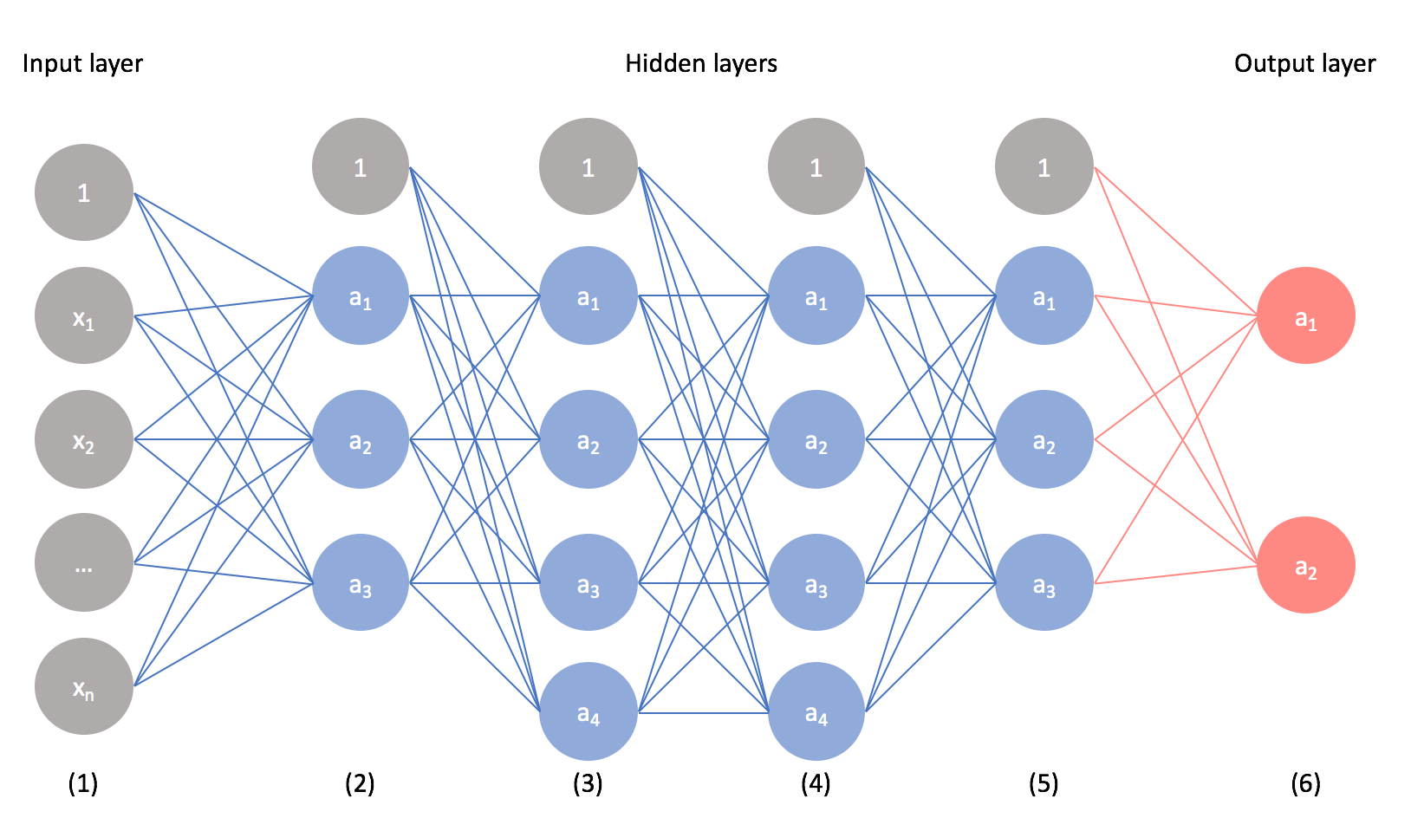
Neural network
Neural networks are powerful algorithms inspired by the structure of the human brain that are used to solve complex machine learning problems. You will build your own Neural Network from scratch to understand how it works. After this course, you will be able to create neural networks for solving classification and regression problems using the scikit-learn library.

Slide 12
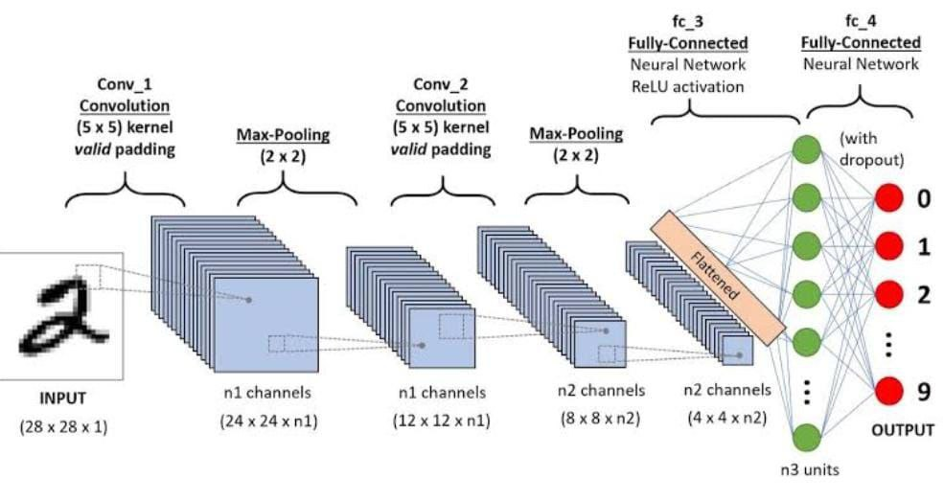
convolutional neural network (CNNs)
CNN stands for Convolutional Neural Network. It is a type of artificial neural network that is particularly well-suited for analyzing visual data such as images and videos. CNNs have revolutionized the field of computer vision and have become the go-to model for tasks such as image classification, object detection, and image segmentation.
CNNs have achieved remarkable success in various computer vision tasks and have been applied in many practical applications such as autonomous driving, facial recognition, medical imaging, and more.

Slide 13
Knee-Osteoarthritis dataset
Knee Osteoarthritis Dataset with Severity Grading (kaggle.com)
This dataset contains knee X-ray data for both knee joint detection and knee KL grading. The Grade descriptions are as follows:
Grade 0: Healthy knee image.
Grade 1 (Doubtful): Doubtful joint narrowing with possible osteophytic lipping
Grade 2 (Minimal): Definite presence of osteophytes and possible joint space narrowing
Grade 3 (Moderate): Multiple osteophytes, definite joint space narrowing, with mild sclerosis.
Grade 4 (Severe): Large osteophytes, significant joint narrowing, and severe sclerosis

Slide 14
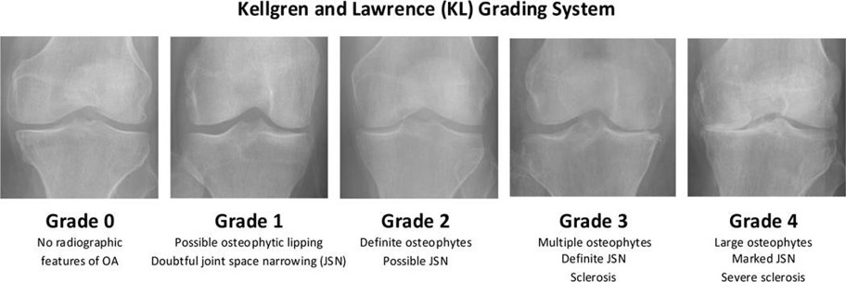

Slide 15
The number of classes in the dataset is: 5​
CLASS​
Healthy​
Doubtful​
Minimal​
Moderate​
Severe​
IMAGE COUNT​
2286​
1046​
1516​
757​
173​

Slide 16
Data Preprocessing
Importance of Preprocessing
Preprocessing involves preparing raw data to ensure it's suitable for model training.
Importance of Data Augmentation
Data Augmentation is the process of creating new data from existing data using various transformations.
Preprocessing and data augmentation are vital steps in developing an AI-based diagnostic system for knee osteoarthritis. They improve the quality of the training data, increase the model's accuracy, and enhance its ability to generalize to new, unseen data. This leads to more reliable and accurate diagnoses, contributing to better patient care and outcomes.

Slide 17
The models tested in the project
1-mobilNet
Limited accuracy and relatively less efficiency EfficientNetB5
2-VGG-16
Slow in training and implementation compared to efficientNetB5 due to the large number of layers and requires a large memory to store the parameters.
3-EfficientNetB5
In the end,we chose the model EfficientNetB5

Slide 18
The model used
EfficientNetB5 is a model within the EfficientNet family, which is a series of convolutional neural networks (CNNs)EfficientNetB5 is an advanced convolutional neural network that combines high accuracy with computational efficiency. Designed with compound scaling, it achieves an optimal balance of model width, depth, and resolution, making it suitable for a wide range of computer vision applications. Its high efficiency and accuracy make EfficientNetB5 an excellent choice for image classification tasks and use in resource-intensive environments.

Slide 19
Create a custom Keras callback to continue and optionally set LR or halt training
The LR_ASK callback is a convenient callback that allows you to continue training for ask_epoch more epochs or to halt training. If you elect to continue training for more epochs you are given the option to retain the current learning rate (LR) or to enter a new value for the learning rate. The form of use is: ask=LR_ASK(model,epochs, ask_epoch) where:

Slide 20
model is a string which is the name of your compiled model epochs is an integer which is the number of epochs to run specified in model.fit ask_epoch is an integer. If ask_epoch is set to a value say 5 then the model will train for 5 epochs. then the user is ask to enter H to halt training, or enter an inter value. For example if you enter 4 training will continue for 4 more epochs to epoch 9 then you will be queried again. Once you enter an integer value you are prompted to press ENTER to continue training using the current learning rate or to enter a new value for the learning rate.
At the end of training the model weights are set to the weights for the epoch that achieved the lowest validation loss

Slide 21
Combine classes
Importance of Combining Classes
Reducing Complexity: Simplifies the model by reducing the number of categories, making it easier for the model to learn and generalize.
Improving Performance: Increases the number of samples in the new combined class, which can stabilize and improve the model’s performance.
Simplifying Interpretation: Makes the model’s results easier to understand and interpret by creating more generalized categories.

Slide 22
Benefits of Combining Classes
Data Consistency: Creates more uniform and less noisy data categories.
Model Accuracy: Improves the model's ability to generalize and reduces bias, especially for rare classes
Combining classes is a strategic step to improve machine learning models, especially when dealing with imbalanced or complex class structures, leading to better performance and simpler results interpretation.

Slide 23
Proposed Model
The proposed model will be discussed in the following subsections. provides the steps of the proposed model:
(1)input the x-ray image,
(2)pre-processing the image,
(3)training the data after we split it,
(4) then classification the degree of the KOA,
And give us the output whether its
Normal or minimal or doubtful or moderate or several

Slide 24
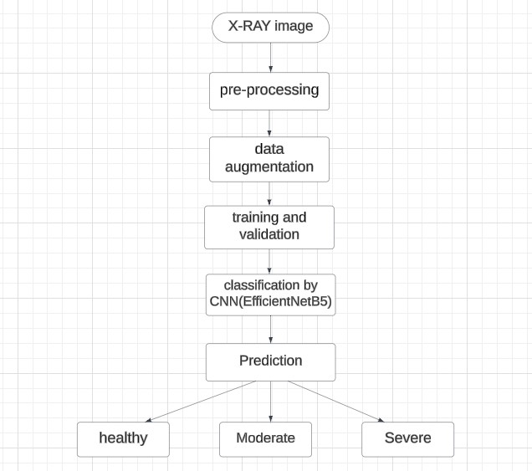

Slide 25
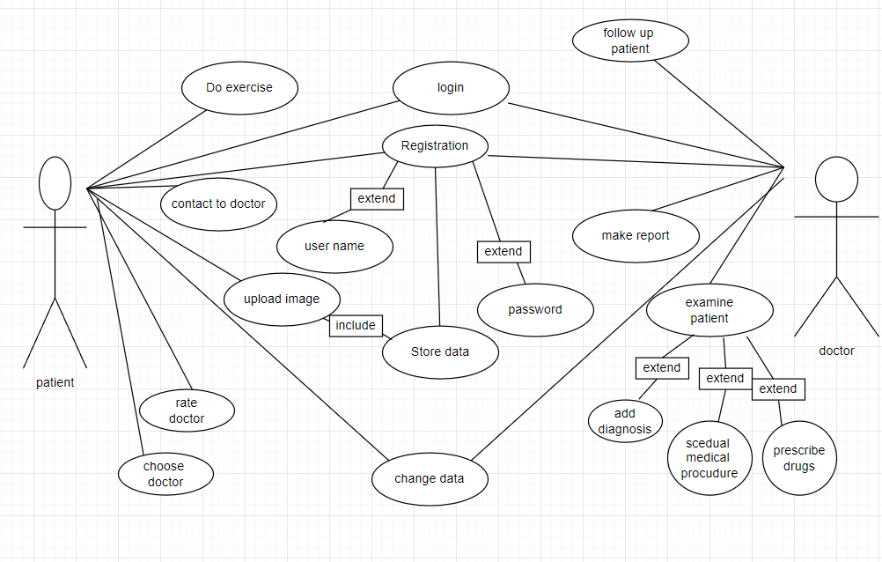
Use Case

Slide 26
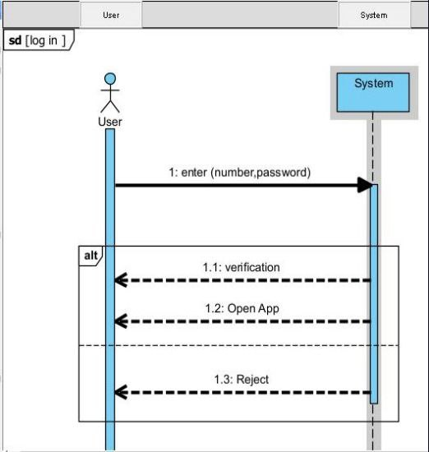
Sequence
diagram

Slide 27
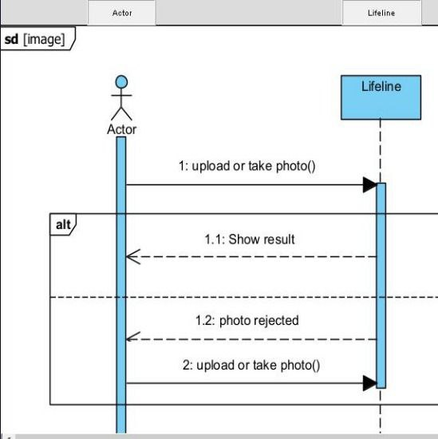
Sequence
diagram

Slide 28
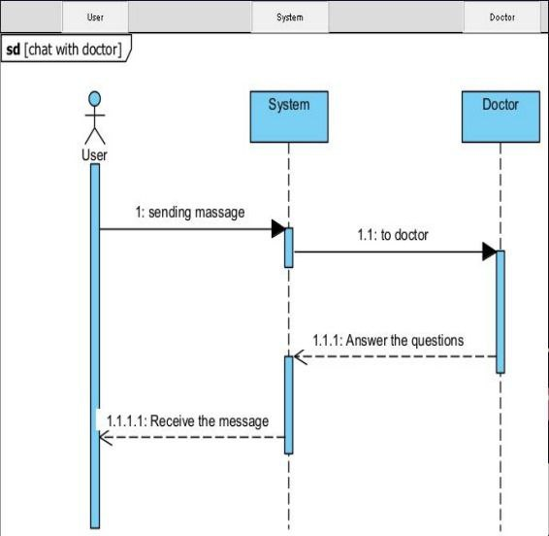
Sequence
diagram

Slide 29
Prototype (UI Design)

Slide 30
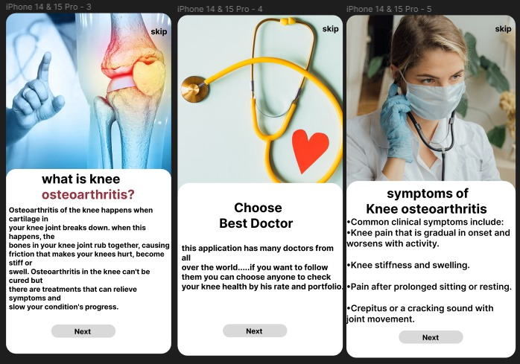
Figure of Description of application

Slide 31
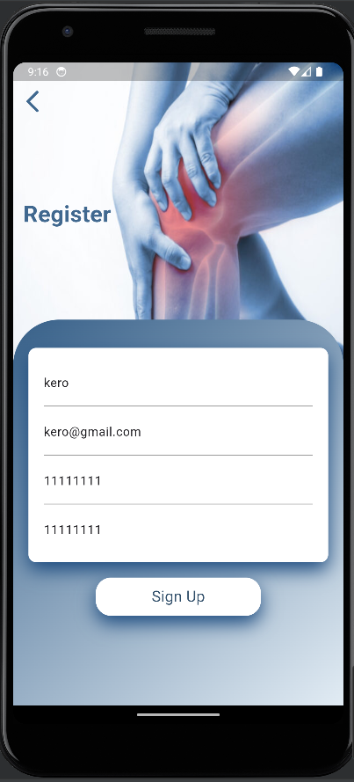
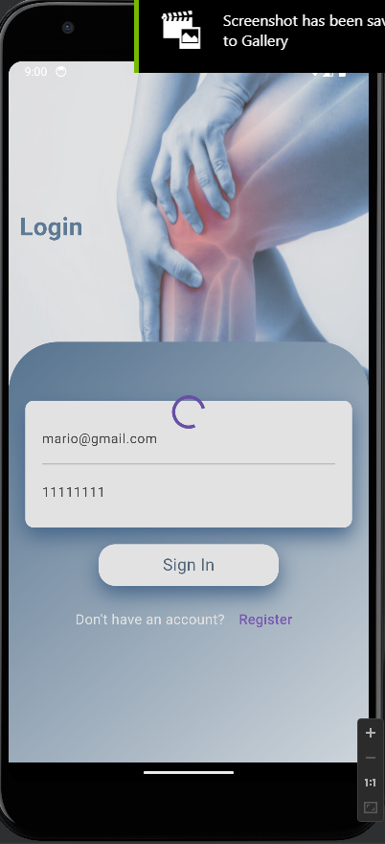
Figure of Sign up Page
Figure of Login Page

Slide 32
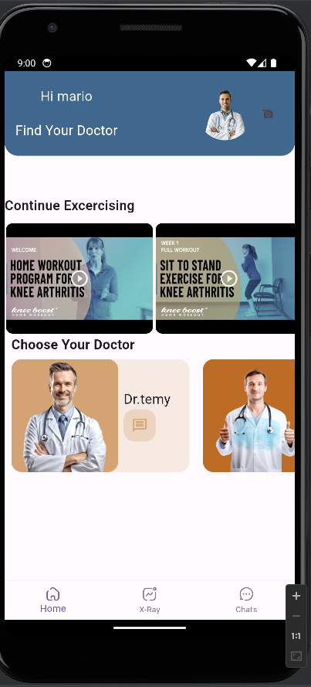
Figure of home Page

Slide 33
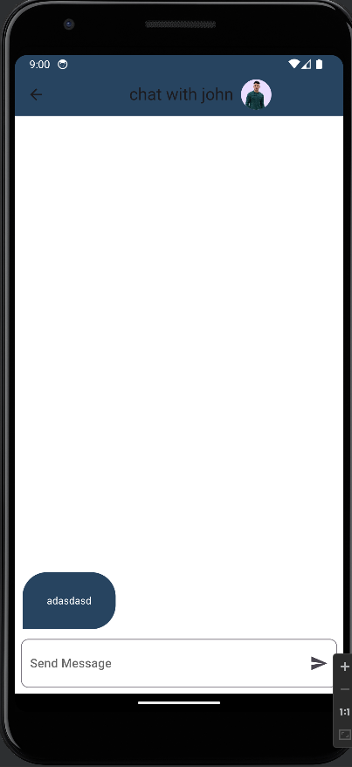
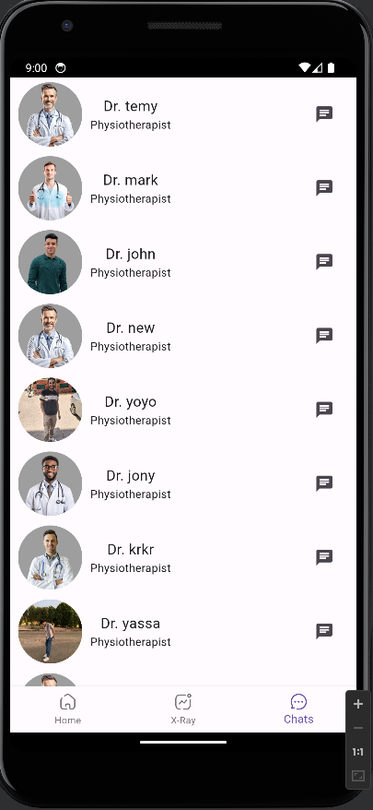
Figure of chat view
Figure of chat list view

Slide 34
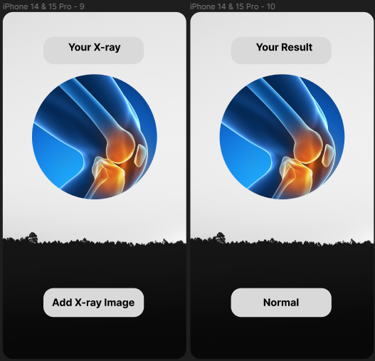
Figure of X-Ray Page
Figure of result Page

Slide 35
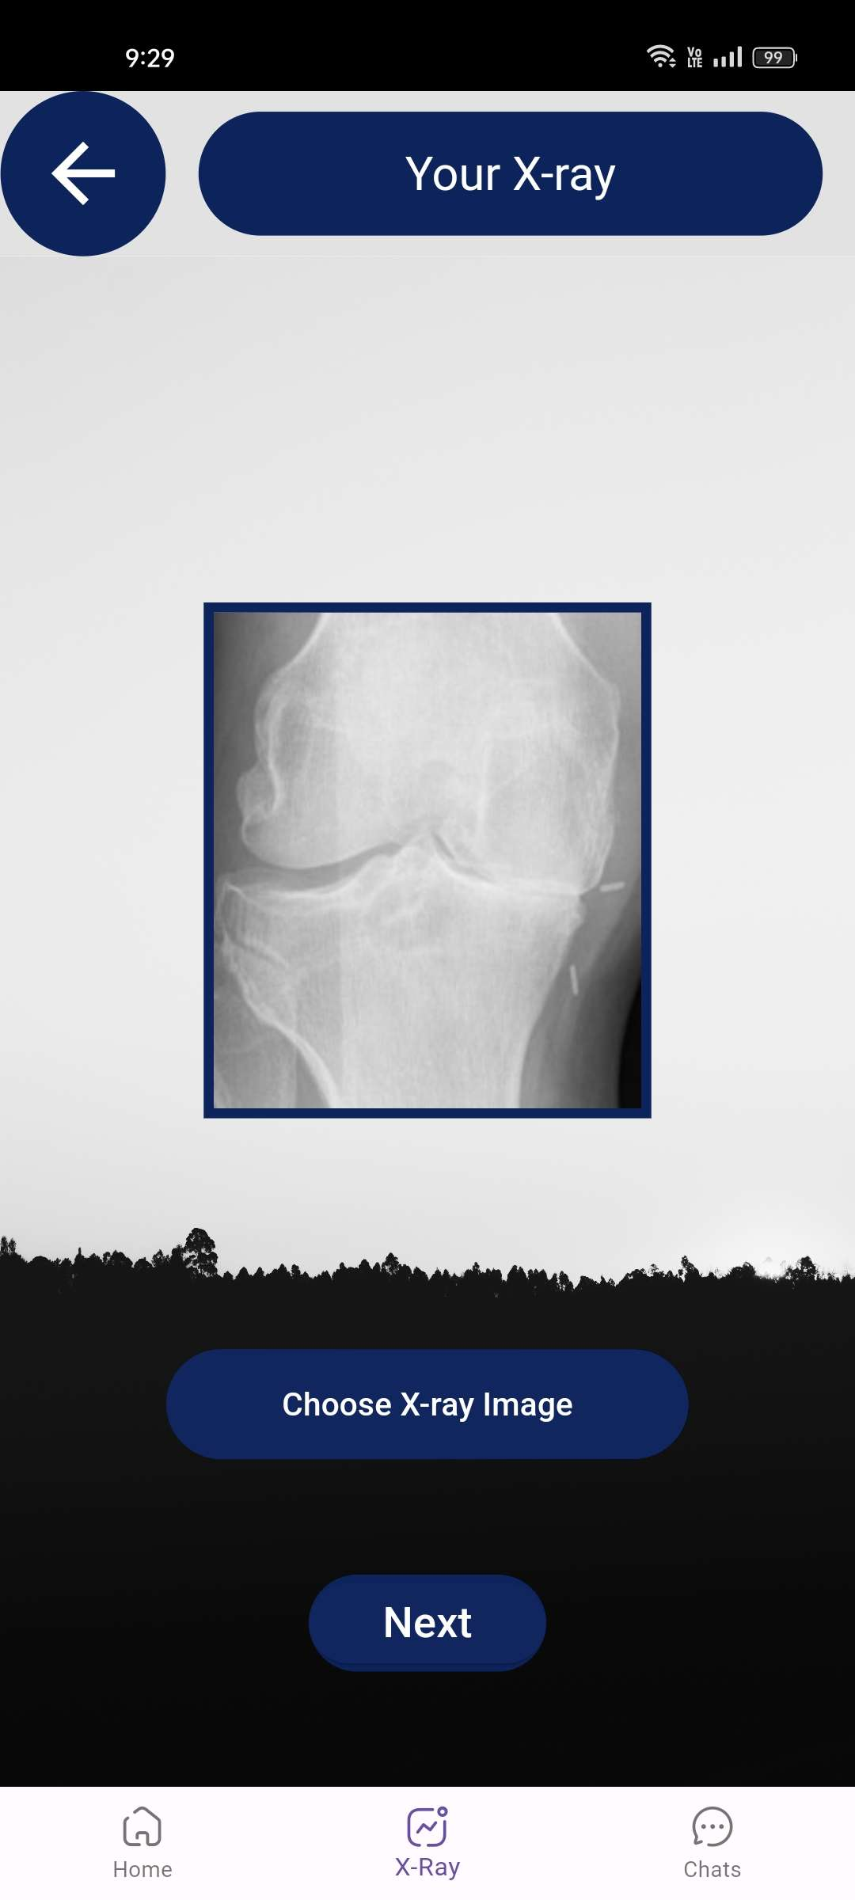
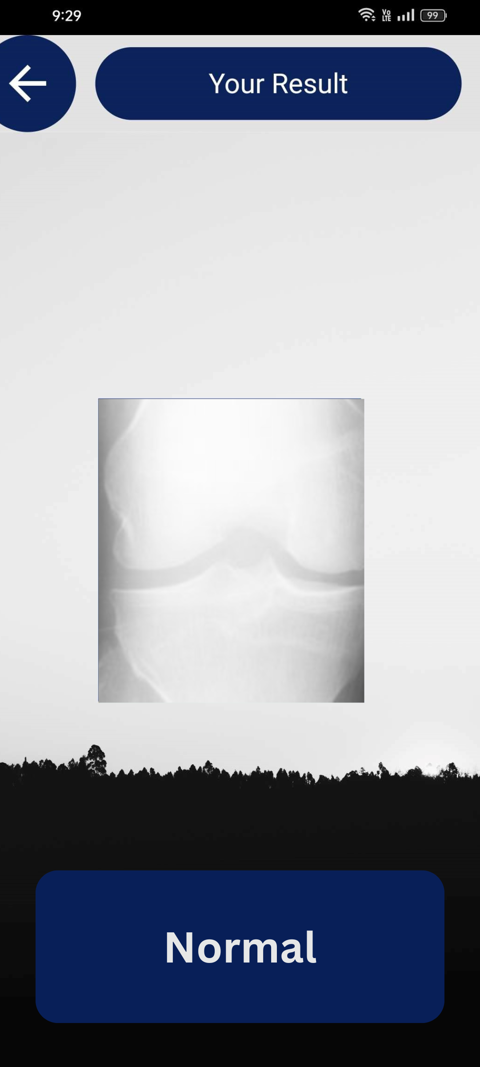

Slide 36
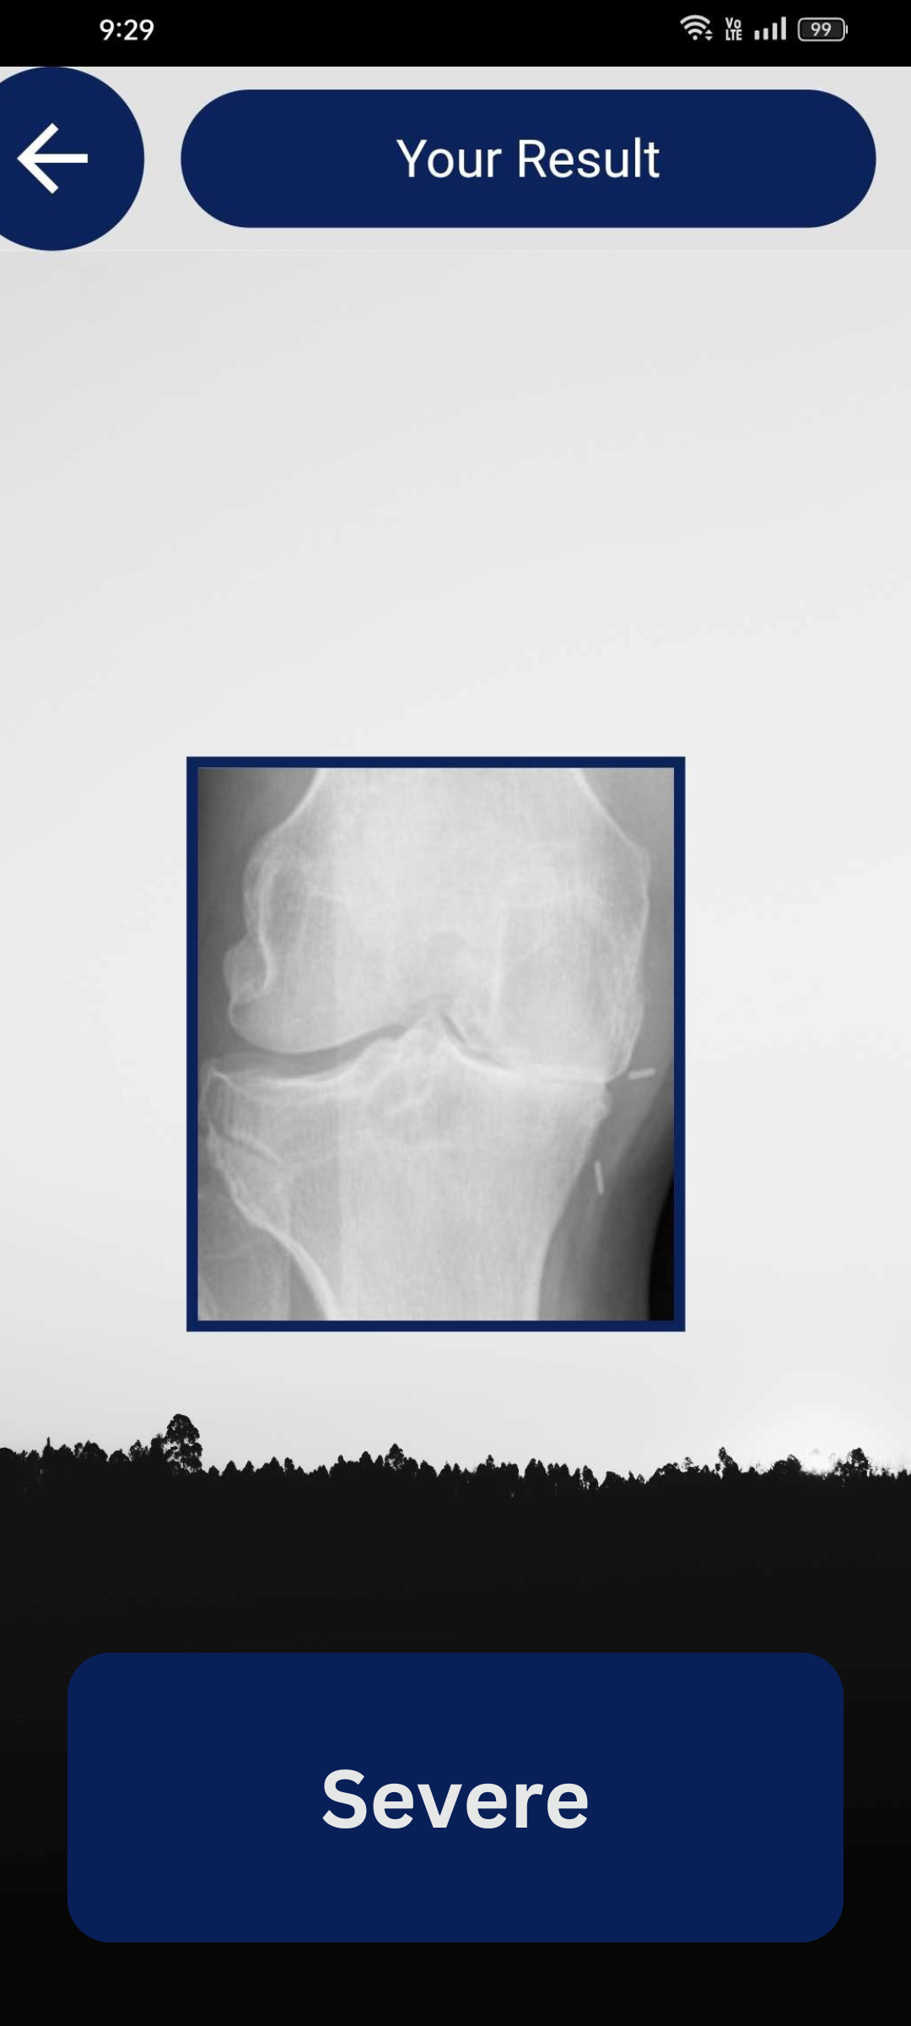
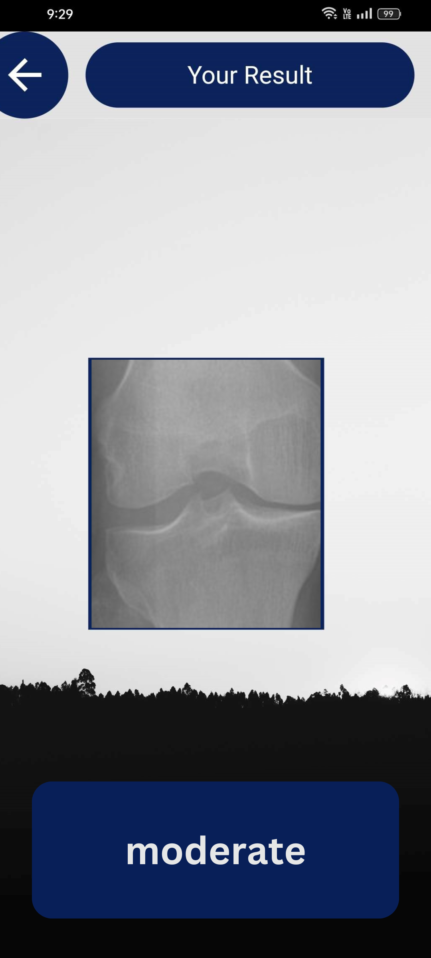

Slide 37
Thanks
Do you have any questions?

